Slide 1
Merchant Payments
PI-23 – 31st October – 3rd November 2023
Lusaka, Zambia

Slide 2
Recap
Pillar 2: Increase adoption of Mojaloop
Merchant Payments is an important use case
Transfers vs Payments:
As far as the flow of funds is concerned both are same.
However, unlike Transfers, Payments
Are Transfers linked to delivery of goods/services.
Are carried out in different modes (Online/Remote, Proximity)
Are of different types (P2G, P2M, Utility Bills etc.)
The goal of this workstream is to
Identify market needs and create necessary tools to support adoption of Mojaloop for Merchant payments.

Slide 3
Our universe of Payment use cases
Payee
Small shop
Large store
Mode
Proximity
Online/Remote
Type
Merchandise
Service (Utility)
Chain store
Government
Channels
USSD
Mobile App
Web
Different merchants have different needs.
Pay in a bank/mobile money account
Pay store-wise
Pay all North region in Bank “X” and South in Bank “Y”
Depending on channel and type of Payee business, important to consider how customer and merchant are notified that a payment is done and goods/service can be given.
How the Payer is interacting with Payee (Merchant) differs between Proximity and Online payments.
Implications on Fraud and Risk Management
Depending on type of payment, there may or may not be a Bill presentment prior to payment.
Contextual information about Payment needs to be exchanged.

Slide 4
Progress since March 2023
PI-21
PI-22
PI-23
Workstream re-initiated
Identified Epics and Stories
Started design of UI/UX for Merchant Portal
Prioritized focus on Small merchants and Proximity Payments
Merchant onboarding & Merchant Registry (Oracle)
Development of Merchant Portal & Registry components (MVP Features)
End-end flow diagrams and documentation of functionality
Enhancement of Merchant Portal with priority features
DA Approval on design and interaction between Merchant Registry and Mojaloop.
Test Case automation and CICD Setup
Complete release Checklist for Beta Release so the components are ready for Production
Integrated Registry with Mojaloop ALS

Slide 5
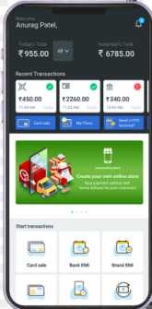
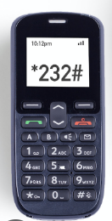
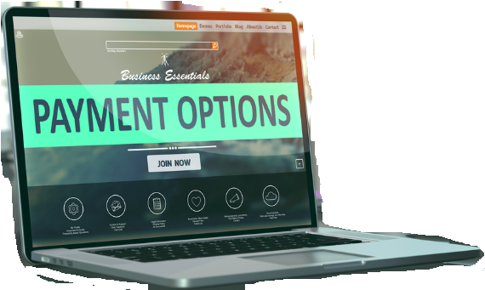
High level architecture
Merchant Payment Tools
Merchant
Onboarding Portal
Merchant
Registry (Oracle)
USSD
APP
WEB
ALS
Customer/Payer DFSP
Mojaloop
Merchant
DFSP

Slide 6
High level architecture – Alternate
Merchant Payment Tools
Merchant
Onboarding Portal
Merchant
Registry (Oracle)
APP
WEB
Customer/Payer DFSP
ALS
PISP
(non-Bank)
Mojaloop
Merchant
DFSP

Slide 7
Merchant Onboarding Portal
Designed for
Hub Operator
DFSP participating in scheme as Merchant DFSP
Merchants
Features
Merchant onboarding life cycle (Approval, Revert, Reject)
Designed to support different types of Merchants
Merchant initiated onboarding (WIP)
Merchant QR generation
Audit Logs

Slide 8
Merchant Registry
Acts as a Central Oracle for Merchant Alias
Centralized Alias generation (either DFSP provided or auto-generated)
Holds Alias – DFSP mapping
API based interface for to request addition in registry
Merchant Onboarding Portal.
Any DFSP participating in scheme.
Interface with Mojaloop ALS
Audit Logs

Slide 9
Demo
Merchant Onboarding Portal & Merchant Registry
Integrated with Mojaloop

Slide 10
Document references
Documentation on Github
https://github.com/mojaloop/merchant-payment-docs
Implementation Repository
https://github.com/mojaloop/merchant-registry-svc

Slide 11
Next Steps
Priority Tasks -
Complete release checklist
CICD setup
Documentation
Release packaging
Security testing
Functionality – backlog
User/Role management UI + integration with OIDC provider
Merchant initiated onboarding request
Design Tasks
QR Code standards
Bulk merchant onboarding support
Adding 2FA on Portals
Request to Pay – Merchant initiated request
Demo Lab Setup
Setup a 24x7 demo lab with Customer and Merchant Apps for adopters to view and run end-end transactions

Slide 12



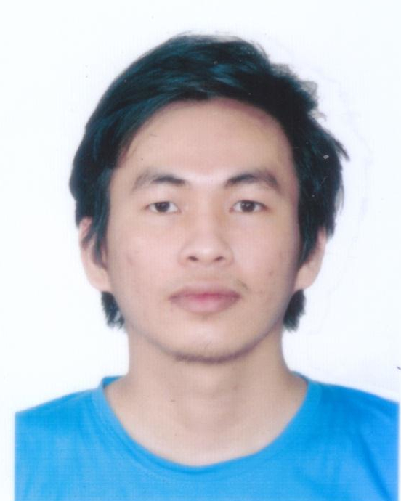


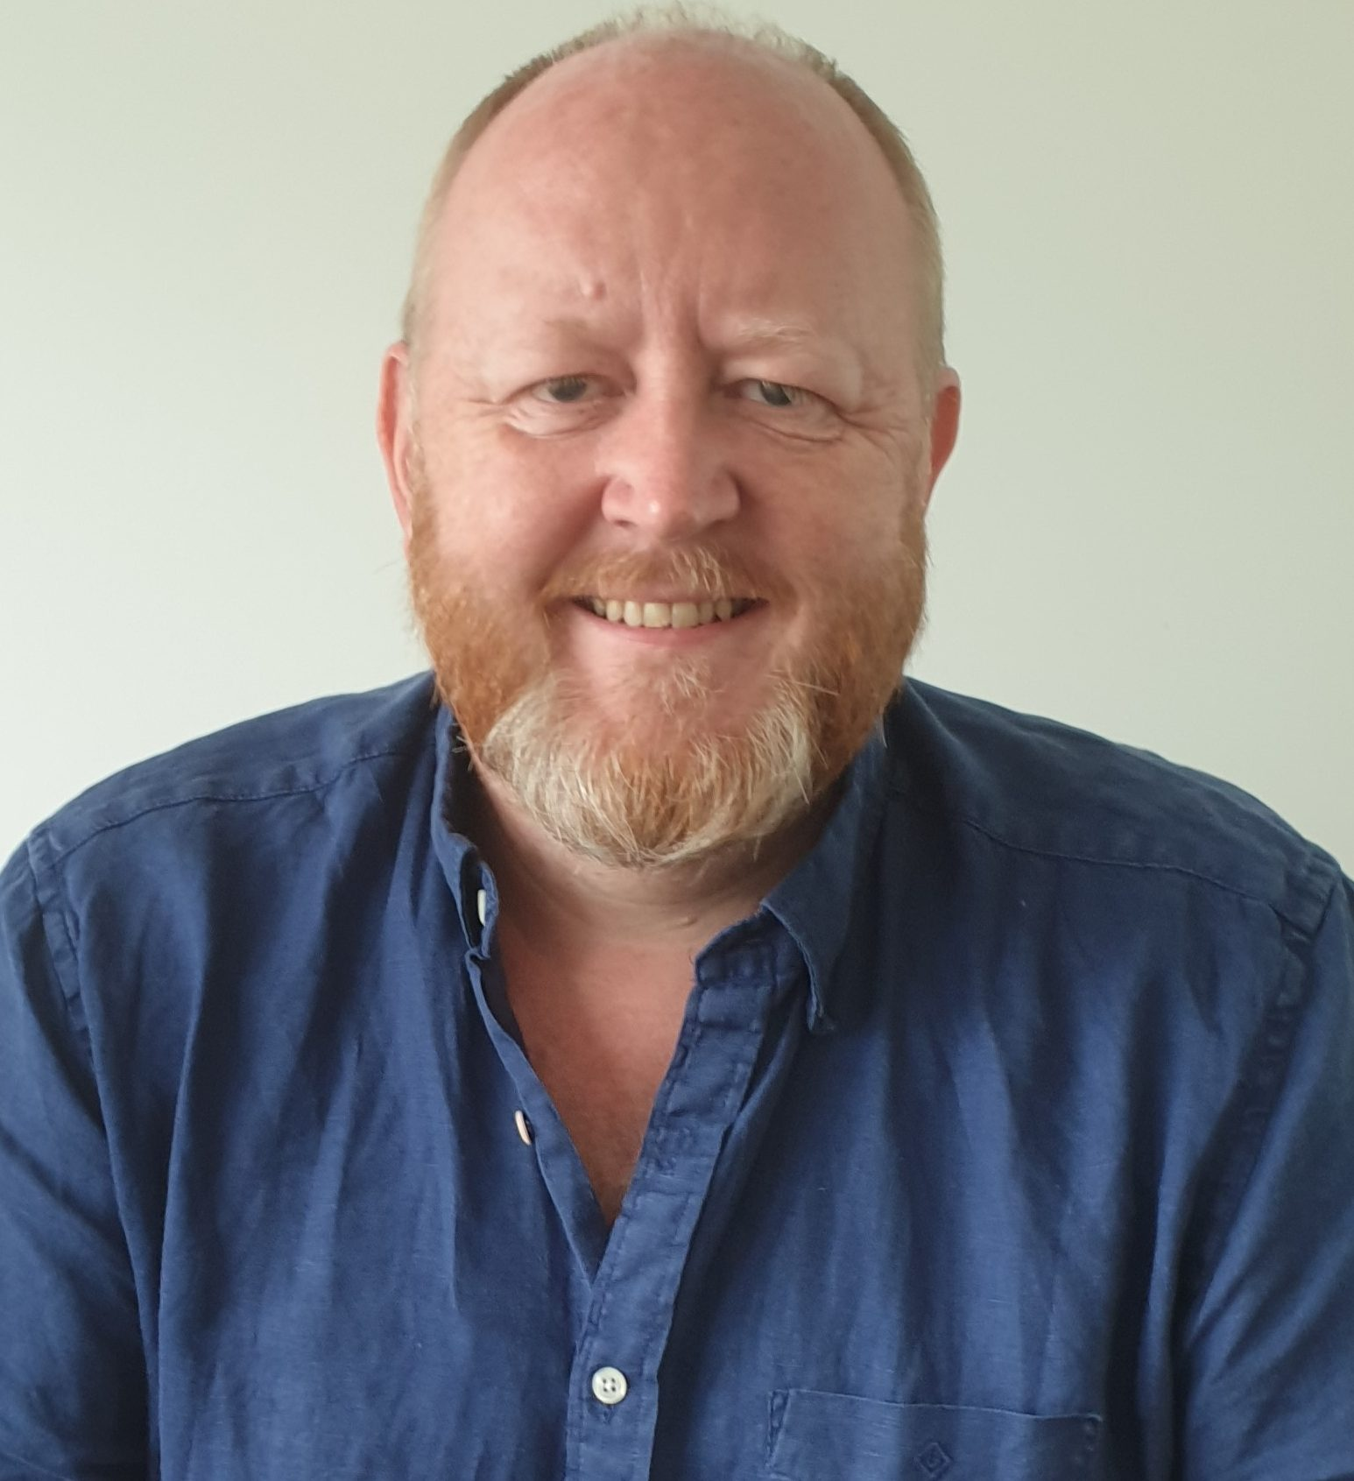


Who has done all this?
Ei Nghon Phoo
Hsu Yee Mon
Naing Lin Kant
Si Thu Myo
Phyu Sin Myat
Taaha Iqbal
Supported by:

Slide 13



Community Support required
Currently active members are from
ThitsaWorks
Paysys Labs
iMoSys
Meeting schedule
Development team
Twice a week – 1 hour
Workstream Update
Every alternate Friday – 30 mins to 1 hour
We need more active participation of other members
DevOPS engineers – helping with CICD tasks
QA/Testing person – Security testing
Adopters – to give feedback on the functionality to be prioritized.

Slide 14
Thank You

